Slide 1
MARCH 20, 2020
Instructions of AACSB Online Teaching Platform
Organizer：OFFICE OF COLLEGE OF MANAGEMENT
TIME：2020.10.06 (TUE) 12:00
VENUE：COLLEGE OF MANAGEMENT 4F
Notes:
首先非常感謝大家今天抽空前來參加AACSB線上教學平台使用說明會。

Slide 2
Key Concept-AACSB
“Regarded as the benchmark of business school quality among the academic community”
Association to
Advance
Collegiate
Schools of
Business
International
Notes:
在介紹教學平台前，我們先來瞭解一下什麼是AACSB。AACSB的全名為 “Association to Advance Collegiate Schools of Business International (國際商管學院促進協會)”，它是全球最具公信力的國際商管認證組織之一，用來評鑑各國各大學的商管學院，通過評鑑後該學校就會取得AACSB認證。
取得認證的學校可以增加學校(授予)學位的國際公信力，有利於學生畢業後申請MBA、到國外念書或找工作等，亦可提高學校競爭力。
本院於2011年獲得AACSB認證，並於今年2017月獲得覆核認證的推薦，為了繼續維持AACSB認證資格，我們須持續執行教學多元評估，確保本院教授的課程能符合AACSB學習保證標準(Assurance of Learning)。

Slide 3
Multiple Assessment
To Cooperate with the standard of AACSB Accreditation, the college set up a self customize sampling teaching evaluation system.
1
Strategic Management & Innovation
2
Participants
Learning & Teaching
Assure that students learned the five core abilities
COMMU,CPSI,LEAD/ETHIC,VSP
3
4
Academic & Professional Engagement
Notes:
AACSB認證標準主要分為四部分，策略管理與創新、參與者、學習與教學以及學術與專業投入。本院為了配合第三項標準—學習與教學，特訂定了一套抽樣教學評鑑制度，也就是教學多元評估，以檢視學生的五大核心能力的學習成效。

Slide 4
1
Communication Skills
Five Core Abilities
(COMMU)
2
Creative Problem & Innovation
(CPSI)
3
Leadership & Ethics
(LEAD/ETHIC)
4
Global Awareness
(GLOB)
5
Values, Skills & Professionalism
(VSP)
Notes:
管院訂定的五大核心能力分別有溝通能力(COMMU)、創新與解決問題能力(CPSI)、領導與倫理思維能力(LEAD/ETHIC)、全球化視野(GLOB)、價值觀、技術及專業度(VSP)。

Slide 5
Learning Objectives Assessment Table of Degree Student
Learning Goals
Learning Objectives
1
Oral Communication/Speaking
Ability to communicate effectively in speaking and in writing
COMMU
Written Communication/Writing
Creativity and Innovation
2
CPSI
Problem Solving
Ability to solve strategic problems with creative and innovative approaches
Analytical & Computational Skills
Leadership
Ability to develop leadership skills required of a person in a leading position
3
LEAD/ETHIC
Ability to demonstrate ethical awareness in learning and in social networking
Ethical & Social Responsibility
4
GLOB
Global Awareness
Ability to possess a global perspective and and awareness of the effects of globalization
Values, Skills & Professionalism
Information Technology
Ability to acquire the skills and values required of a true professional
5
VSP
Technical Skills
Management Skills
Notes:
在五大核心能力下，分別對學士班、碩士班及博士班有不同的學習重點。

Slide 6
Learning Objective Assessment Table of Master Student
Learning Goals
Learning Objectives
1
Speaking
Ability to appreciate business research and to present research findings/results effectively in speaking and in writing
COMMU
Writing
Critical Thinking/Innovation
Ability to integrate different functional areas in solving business problems
2
CPSI
Interdisciplinary Competence/
Problem Solving
Ability to analyze business situations and to recommend innovative resolutions
Leadership
Ability to demonstrate leadership skills of a business manager
3
LEAD/ETHIC
Ability to identify ethical dilemmas and to determine necessary courses of action
Ethical Reasoning
4
GLOB
Global Vision
Ability to possess a global economic perspective and an awareness of the global business
5
VSP
Ability to coordinate actions and solve problems jointly with other members of a professional team
Teamwork

Slide 7
Learning Objective Assessment Table of Doctor Student
Learning Goals
Learning Objectives
Communication/Presentation
Ability to present and to publish business research findings/results
1
COMMU
Publication
Ability to evaluate, interpret, and synthesize existing business knowledge and to propose innovative research
2
CPSI
Creativity in Research
Coordination
Ability to coordinate different research groups and partners
3
LEAD/ETHIC
Ability to undertake various academic activities in an ethical way
Ethical Behavior
Ability to engage business research in a global level
4
GLOB
Global Mindset
Ability to undertake local business research with a global mindset
Ability to qualify for a business research/faculty position
5
VSP
Professional Qualification
Ability to competently teach business courses at the collegiate or above levels

Slide 8
AACSB Online Teaching Platform
System to transferred students’ semester result into five core abilities automatically
Example:
Core
Ability
Homework
(20%)
Mid-Term
(40%)
Final Exam
(40%)
Semester Result：
=80*20%+90*40%+90*40%
=88
COMMU
50%
40%
CPSI
20%
COMMU Ability Result：
LEAD
60%
= 80*50%+90*40%
GLOB
50%
50%+40%
VSP
50%
=84
Score
80
90
90
Please Note：AACSB Online Teaching Platform ≠ Moodle System
Notes:
為了簡化教學多元評估的過程，也就是將每一位學生的學習成績換算成五大核心能力的成績，所以管院特建立AACSB線上教學平台(這邊要特別澄清一下，AACSB線上教學平台與moodle不同)。
有參與教學多元評估的課程會有這個表，老師會根據每個評分項目給予五大核心能力的比重，等等會show出系統內的畫面給大家看，只要將比重設定好，系統就能幫大家將學習成績成功轉換成五大核心能力成績。

Slide 9
Learning Performance Metric
Performance
Metric
Measurement
Categories
Rating
Scale
Expected
Percentage
Undergraduate Score
Exceed
expectations
BA Score ≧ 80
MBA/PhD Score ≧ 90
Excellent (E)
5
≧ 20%
BA 70≦Score ≦ 79
MBA/PhD 80≦Score ≦ 89
Good (G)
4
Meet
expectations
≧ 70%
BA 60≦Score ≦ 69
MBA/PhD 70≦Score ≦ 79
Average/Credit (A/C)
3
Do not meet
expectations
BA Score < 60
MBA/PhD Score < 70
BA ≦ 20%
MBA/PhD ≦ 10%
Unacceptable(U)
2
Notes:
管院針對核心能力成績有訂定一個學習表現衡量尺度表，Summary Report的部分會以五分制的形式顯示成績，
學士班的部分80分以上，轉換成五分制為5分，
而碩博士班的部分，則要90分以上才為五分制的5分。
另外，這邊這個Expected Percentage的部分，則是管院希望每個核心能力達到Excellent程度的學生能高於20%。學士班學生核心能力為Unacceptable者能低於20%，碩博士班學生核心能力為Unacceptable者能低於10%。
示範課程再撰寫Closing the Loop報告時，老師們能根據這個衡量尺度表，檢視學生們各個核心能力的表現。

Slide 10
Multiple Assessment Portfolio
Courses that attended the Multiple Assessment should ask the department office for the multiple assessment portfolio or print it down from the platform.
Course Syllabus
Detailed Worksheet on Final Grades
Summary Report
Closing the Loop Report
Only for core courses
Can Also Included：exam answer sheet, project report on CD etc.
Notes:
學期末的時候，管院會向大家收取教學多元評估資料袋，學期中要在平台輸入各項成績，學期末時到系辦要資料袋(牛皮紙袋) ，
一般非示範課程，一定要放入課程大綱、學期成績單、Summary Report。
Summary Report是用線上教學平台匯出的統計資料，後面會說明。
如果是示範課程，除了上述的三樣東西之外，還要多放入課程Closing the Loop Report。
這個課程Closing the Loop Report也是在系統輸入資料後，可從系統輸出並列印的表單，之後我們講平台使用說明的時候，再細講。
那除了以上硬性規定要繳回的東西之外，亦可以將考卷、報告、或是將課程所有的內容燒成光碟，一併放進資料袋中繳回。

Slide 11
Data
What
is
Closing the Loop
Execution
Reports
Models
Analysis
Notes:
Closing the Loop是一個我們用來檢視本院所教授的課程，能不能保證學生學到五大核心能力的重要觀念。
其實就是請老師們根據系統內所輸出的資料，以及資料袋的內容，檢視學生各個核心能力的學習狀況，例如：系統資料輸出後，老師發現學生在溝通能力上很好，但在領導與倫理思維能力上表現較差，那這時候老師就可以思考是不是課程設計上太偏重於溝通能力的訓練，或是成績比重分配不均等等的因素造成這個結果，下次設計課程的時候，就可以將這些因素考慮進去，看是否要重新設計課程，讓學生在學習上能更達到老師設定的預期成效。這就是Closing the Loop (學習閉環)。
各位助教在此閉環的重點工作則是幫忙蒐集學生的自我評估表、報告、成績單匯整後，繳回管院辦公室。

Slide 12
AACSB Online Teaching Platform Website
1
Website Address:
AACSB Online Teaching Platform
http://aacsb.management.ncku.edu.tw/
2
Front page of College of Management
Department and Center
Click the AACSB Online Teaching Platform
Notes:
開始進行線上教學平台使用說明。
首先要如何進入AACSB線上教學平台呢？
有兩個途徑：1. 一個是輸入網址 2. 另一個方法則是上成大管理學院網站裡面有AACSB平台連結

Slide 13
AACSB Online Teaching Platform Log in
TA please use Students ID to register, meanwhile please help other students to register.
Please use the Account and password if you have registered already. (Student Present account: Student Number/ Last 4 digits of Student ID)
Please connect to the case officer in each department or Me if you forget your password
The system will distinguished the identity automatically
Ps.：If the same account have different identity, please select one when you log in
Students/TA can register of look up for password here
Notes:
進入之後，如果你是第一次使用AACSB平台，需先註冊帳號。
先輸入帳密，帳號是你的學號，密碼預設是學號後四碼，然後系統會自動辨認你的身份，如果你有兩種身份，同時是學生及助教，輸入完帳密後在「登入身份」選擇。

Slide 14
Account of Faculty – Log in
FIRST！ Start New Course
(CAN NOT Update/Reuse the old courses)
Even if the academic or the semester is different, it’s a new course.
NOTICE: Only the ACCOUNT OF FACULTY can use the function Start New Courses
Notes:
這裡有一點需要注意就是，只有「教師帳號」才能開新課程，所以開新課程時務必使用老師的帳號。
這邊要注意：開新課程絕對不能用舊的課程進行更改，一定要重新開一門新課，否則系統會有問題。

Slide 15
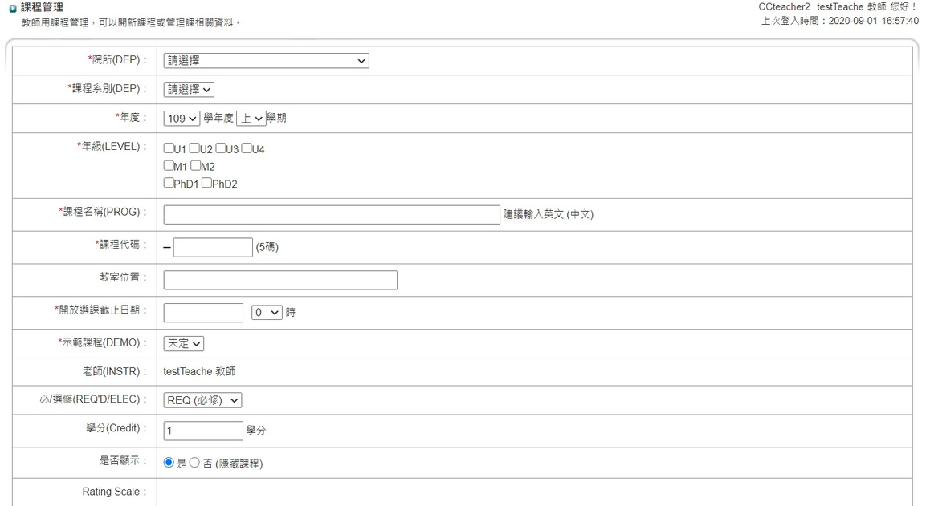
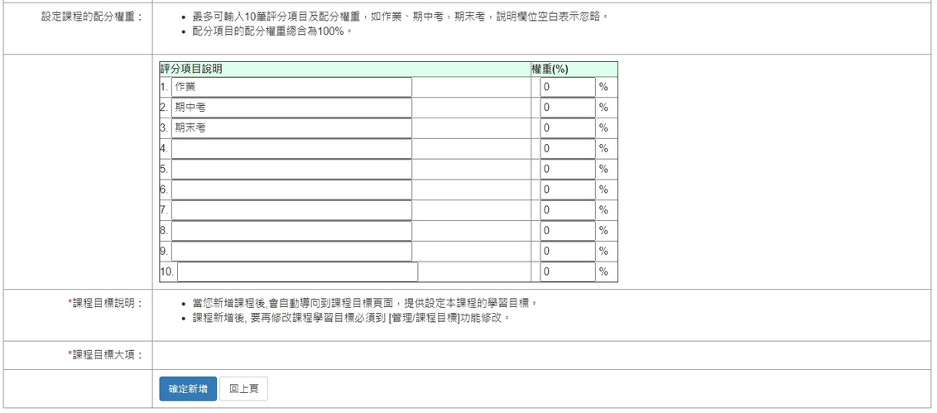
Account of Faculty
-Start New Courses
Fill in the basic information of the courses
「*」are required to fill in
After select the Department/Institute, system will distinguish the Rating Scale automatically
The total weighting of the rating item should be 100%
For Name of the course and Rating item description, please fill in English
In the end, please click 【確定新增】 to finish the processes
Notes:
按「開新課程」後就會進入這個畫面，填入課程基本資訊，有打星星為必填欄位，選擇系所別後，系統將自動判定是學士班、碩士班或是博士班的rating scale，就是評分標準，課程評分項目所有權重加總總合應為100%。輸入課程名稱及評分項目時請務必以英文為主。
完成後按[確定新增]即完成開課手續。

Slide 16
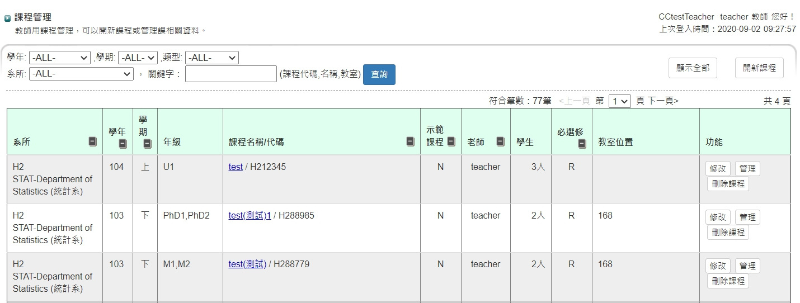
Account of Faculty
-Start New Courses
For Same Department/Institute that start a new courses, please follow the course code that the school show to set the new course
EMBA from each Department/Institute Please use the Master degree to start the new courses, then go back to the manage list and change the degree on the right hand side
Notes:
還有一點也是需要大家稍微注意的地方，就是在選擇系所別的時候，請務必要選擇正確，否則屆時本院在查詢的時候，會出現問題。

Slide 17
Account of Faculty
-Single Management of the Course
Edit Course Information
Click the name of the course then go into the page of the edition
Faculty can click the different function according to different course
Notes:
再來是課程後續處理方法，點選要編輯的課程後就會進入這個畫面，上面所有的功能選項都可以點選，稍後我們將會做介紹。

Slide 18
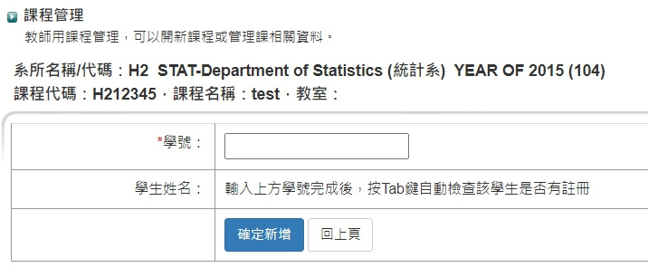
Account of Faculty-Set for TA
【SETTING FOR THE TA】
After the Faculty add the TA, the TA will have the permission helping faculty to set up all the course information
Click 〔Add〕, then enter the Student ID
Notes:
【助教設定】→按「新增」就會進入這個畫面，老師輸入「助教學號」後按「確定新增」，該名同學即為該堂課的助教，就有權限協助老師設定所有的課程資訊。
請各位助教一定要提醒老師做助教的設定，不然就沒有辦法幫老師做課程的管理了！

Slide 19
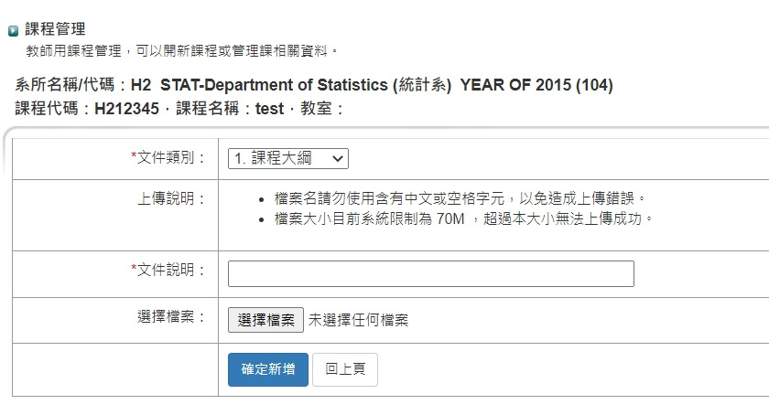
Account of Faculty/TA
-Document of Course
【DOCUMENT OF COURSE】
Faculty/TA please upload the Syllabus of the Courses(Please download the example of Syllabus first, after finish fill in the information, please upload it again)
Notes:
【課程文件】→按「新增」就會進入這個畫面，按「瀏覽」選擇你要上傳的課程教材，像課程大綱等，之後按「確定新增」即可。

Slide 20
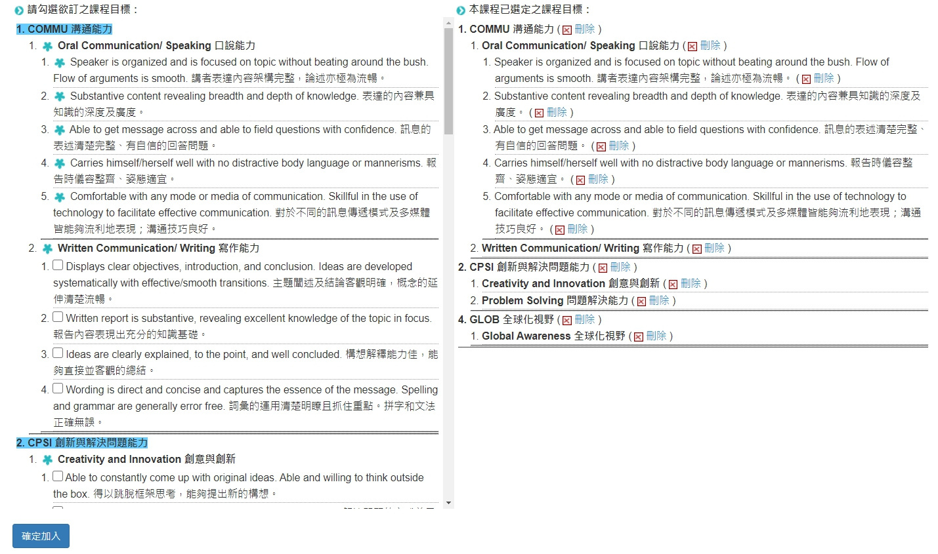
Account of Faculty/TA
-Learning Goals of the Course
【Setting Learning Goals】
Faculty/TA please select the Learning Goals from the left hand side
Meanwhile select the Learning Objectives of the courses
If the Learning Objective has been selected, the Learning Goals will also be selected the item will be show in blue flower
Learning Objective for Degree/Master/Doctor Students will be different
Notes:
首先先按【設定課程目標】就會出現這樣的畫面，一開是右邊選項是空白的，勾選該課程的五大核心目標以及問卷題項後，按「確定加入」後，勾選完的細項會顯示(小花)，並且右邊會呈現你勾選的項目，如果你不小心勾錯或要刪除，可直接按右方欄位的「刪除」即可。
這邊也有一個稍微要注意的地方，就是因為大學部、碩士班以及博士班的學習目標不同，所以請各位助教要提醒老師在前面開課時所輸入的基本資訊，要正確，否則屆時跑出來的資訊就會有誤。

Slide 21
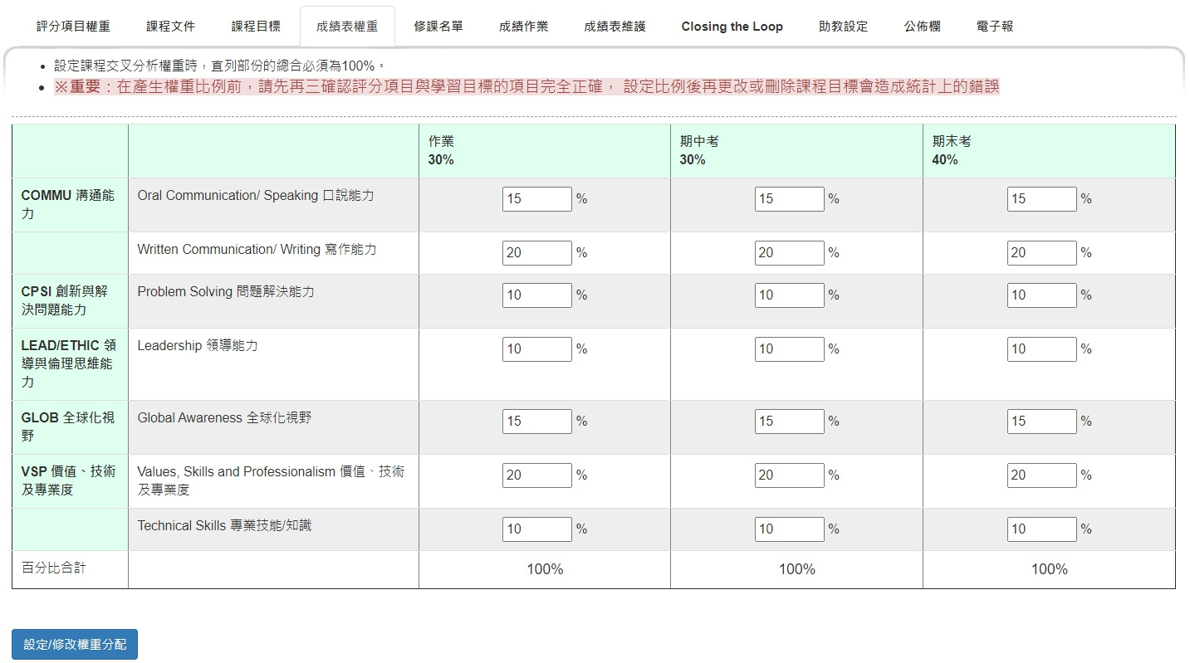
Grade Weighting
【Grade Weighting】
According to the setting of the Grading Policy in Syllabus, please fill in each weighting
System will confirmed automatically that the sum of each column should be 100%, each row should NOT be 0
Notes:
【成績表權重】設定
最左邊這一欄出現的是剛剛在【設定課程目標】選擇的五大核心目標，上面的欄位是這堂課的評分項目，依不同的評分項目，設定五大核心目標的比重為多少在框框內直接輸入比重，這裡要特別注意每一直列的總合為100%，還有在依老師的syllabus輸入比重時要注意輸對行。
舉個例子來說，像作業30%指的是佔學期分數的百分之30，而這30%包含了15%的speaking、15%的writing、20%的problem solving等等。
根據以往輸出的報告常發現課程中會出現老師沒有勾選的核心能力目標，造成成績換算上的錯誤，因此特別在系統中加註請老師及助教確認評分項目與學習目標都無誤後再來設定這個部分，避免之後出現計算上的錯誤。

Slide 22
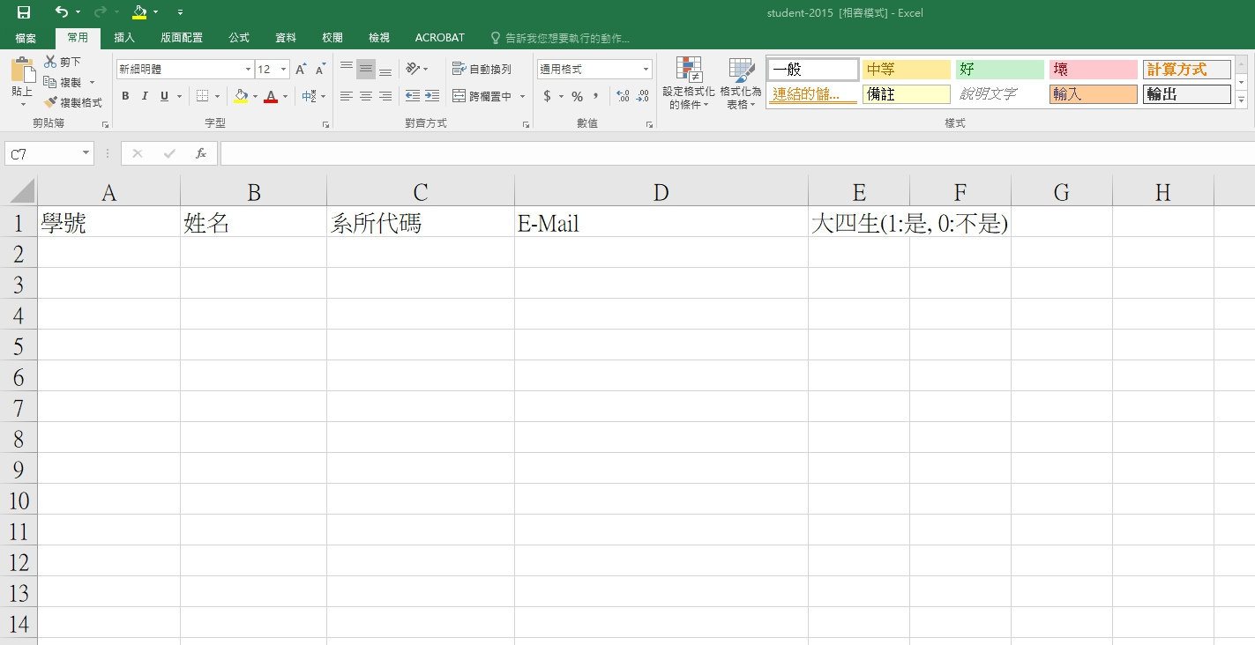
List of the Students
Enter students information Save
Import the file
Notice！
Student who drop/audit the course of take a temporary leave will not be score
Notes:
【修課名單管理】→可選擇單筆輸入或整批匯入
選擇單筆輸入的話，按「新增」後輸入學號，之後按「確定新增」即可。
選擇整批匯入的話，則按「匯入名單」後會出現這樣的畫面，使用匯入功能時，可下載範本，這裡有一個「連結下載」，點入後會出現一個固定格式的EXCEL檔，檔案裡必填的資訊有學號、姓名、系所名稱及email，填寫完畢後，按「瀏覽」選擇檔案，之後按「確定新增」即可。
注意如果非管院的學生，需請助教先協助學生註冊帳號，再將此學生加入修課名單。

Slide 23
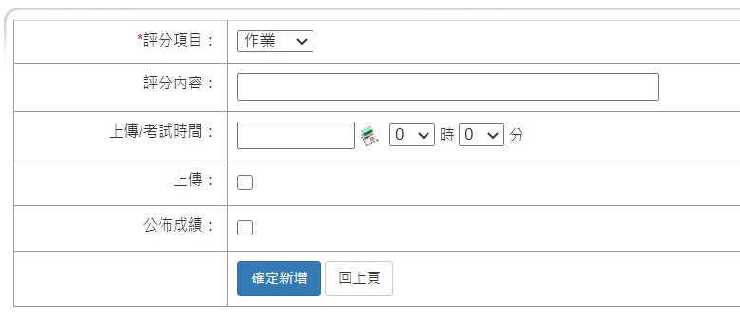
Grade and Assignment
【Grade Management】
Each rating type (eg. Assignment/Mid-term/Final Exam)
If upload the assignment is needed, please click “Upload” then set the deadline
If students cannot had in the assignment on time, the score will be unable to announce
Notes:
【成績作業管理】按「新增」後進入的畫面
首先選擇評分類型像作業/期中考/期末考，可選擇是否上傳作業或公佈成績給學生看，之後按「確定新增」即可。

Slide 24
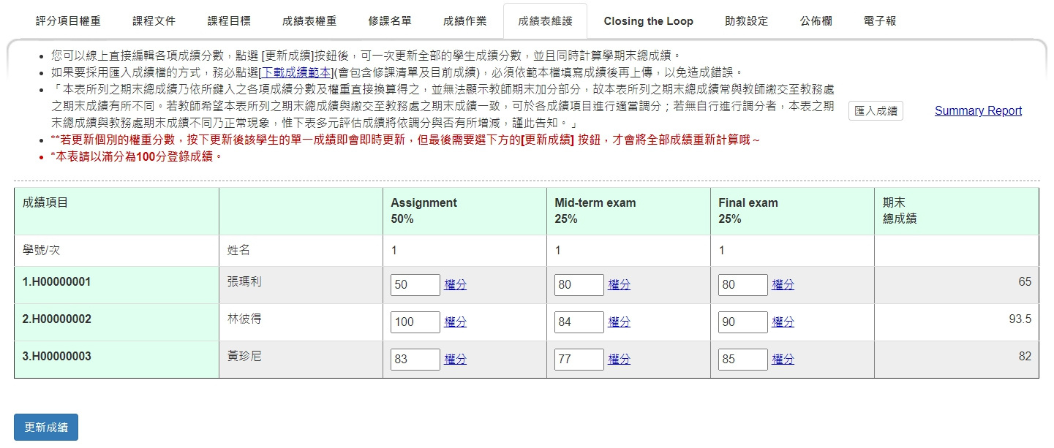
Maintenance of the Score Sheet
Can edit each score online directly, or download the Sample first then follow the format of the EXCEL to enter the score, then import to the system
Please click 〔更新成績〕 after you finished
Suggest to use the Sample, please fill in the score even it’s 0!!
Notes:
【成績表維護】
輸入成績的方式也有兩種，一種是直接在框框內直接輸入。另一種則是整批匯入。
首先先點選「下載成績範本」，之後會出現一個固定格式的excel檔，檔案會自動出現所有修課同學的姓名、學號及評分項目，之後將成績依序填入後(若學生成績是0分也是要填)，再按「匯入成績」，最後按「更新成績」，即完成登錄作業。

Slide 25
Summary Report
【Maintenance of the Score Sheet】
Close to the end of the semester, please hand in the 〔Summary Report〕 to consolidate and calculate the score
Click 〔Summary Report〕 then get into the course Final Summary Report (See next slide)
Notes:
1. 這邊是Summary Report在系統中匯出的結果，這邊要注意紅色框框內的人數加總一定要等於修課人數，如果有誤的話，可以重新按一次 “更新成績”，還是不行的話可能是系統有問題，聯絡管院以修正此問題。
2. 要特別注意，若更新個別的權重分數，需要按下方的[更新成績]按鈕，系統才會將全部成績重新計算，本表請以滿分為100分登錄成績。

Slide 26
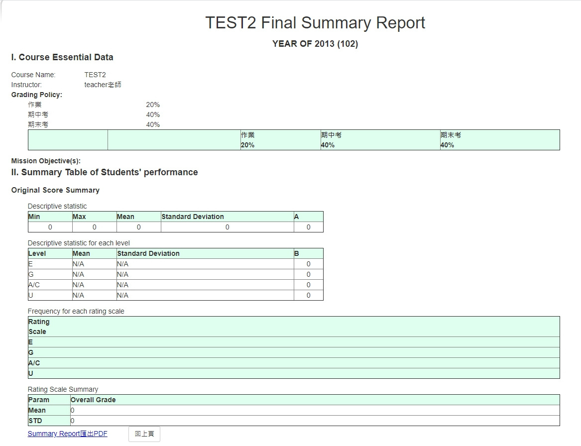
Summary Report
【Summary Report】
Go to the page of Final Summary Report, you can see the 〔Summary Report 匯出 PDF〕, click then export the PDF of Summary Report
Notes:
之後按左下角的Summary Report匯出PDF即可產生PDF檔，再放入資料袋中。

Slide 27
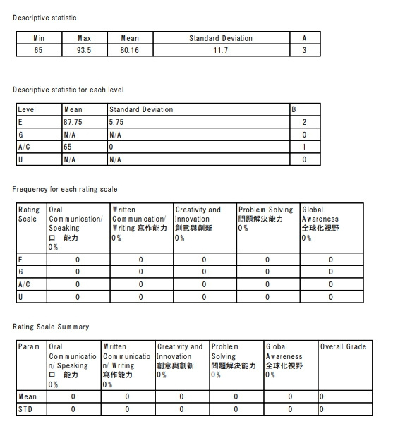
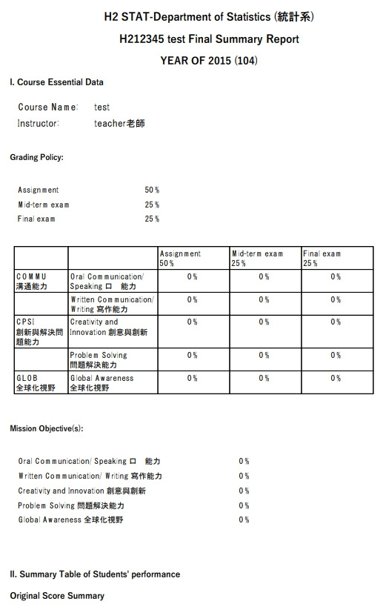
Summary Report
All the three part need to be equal to the number of students who take the courses
Actual Export of the Summary Report
Notes:
這兩頁是Summary Report輸出成PDF檔的樣子

Slide 28
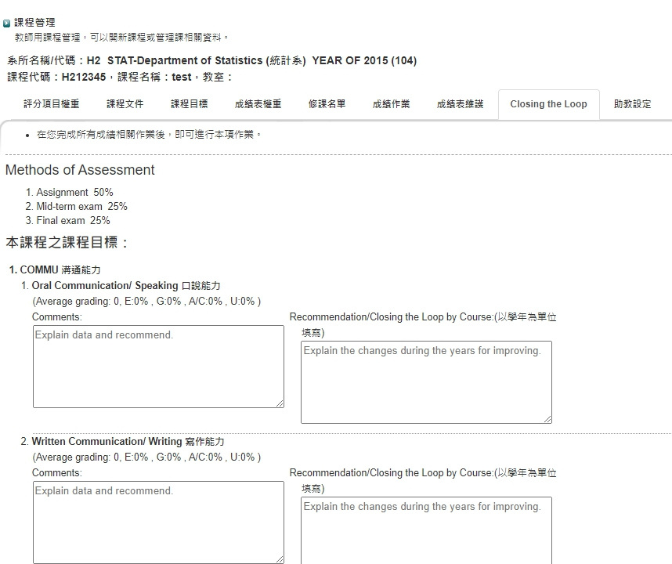
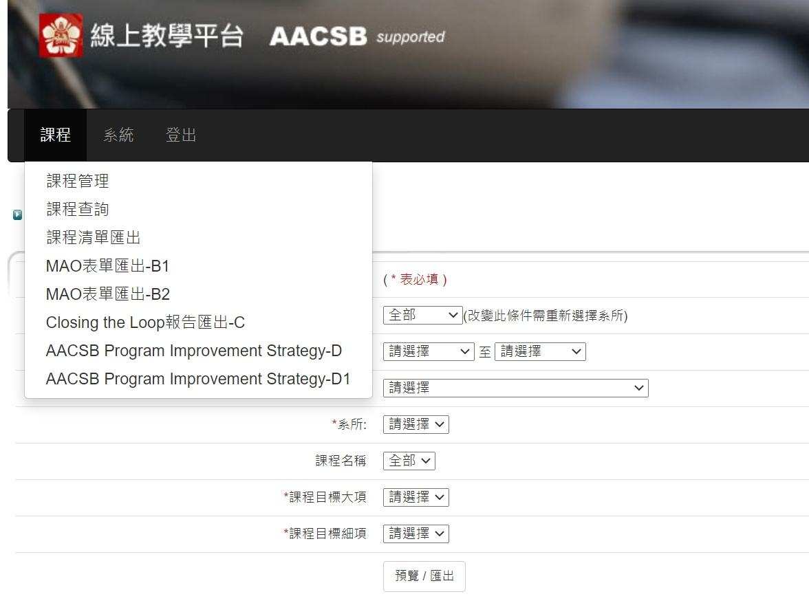
Closing the Loop
Faculty Report Fill In
Export the result according to each item

Slide 29
Bulletin Board and Newsletter
【Bulletin Board】
【Newsletter】
Click 〔Add〕, enter the information that want to share with the students, after that click 【Confirm to Add】 Back to the list and click 【發送】 【確定發送】
「*」is required to fill in
Click 〔Add〕, enter the information that want to share with the students, after that click 【Confirm to Add】
「*」is required to fill in
NOTICE：
The difference between Bulletin Board and Newsletter is that Newsletter can share the course information with students through E-mail
Notes:
老師有想要向修課同學公告的訊息，可利用公布欄的功能。點選「新增」，再填入「消息標題」及「公告內容」，按下確定新增即可。
電子報則是將資訊以email方式寄送給學生。

Slide 30
Student Account Log in
1
2
3
4
5
6
7
1
Look up the courses basic information
2
Bulletin Board
3
Courses Materials Download
4
Upload Courses Assignment
5
Semester Result (Students can only check their own score)
6
Self-Evaluation
7
Result of Learning Objective

Slide 31
系所辦公室帳號登入
1
2
Courses Management
1
Manage/Look up all the courses information set up by its department
System Management
2
Manage/Look up all the accounts information from its department (Included Faculty/TA/Students)

Slide 32
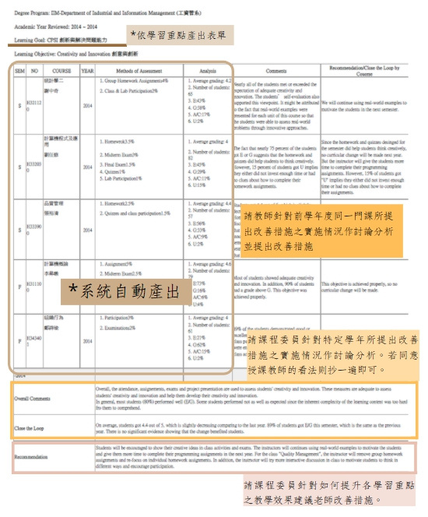
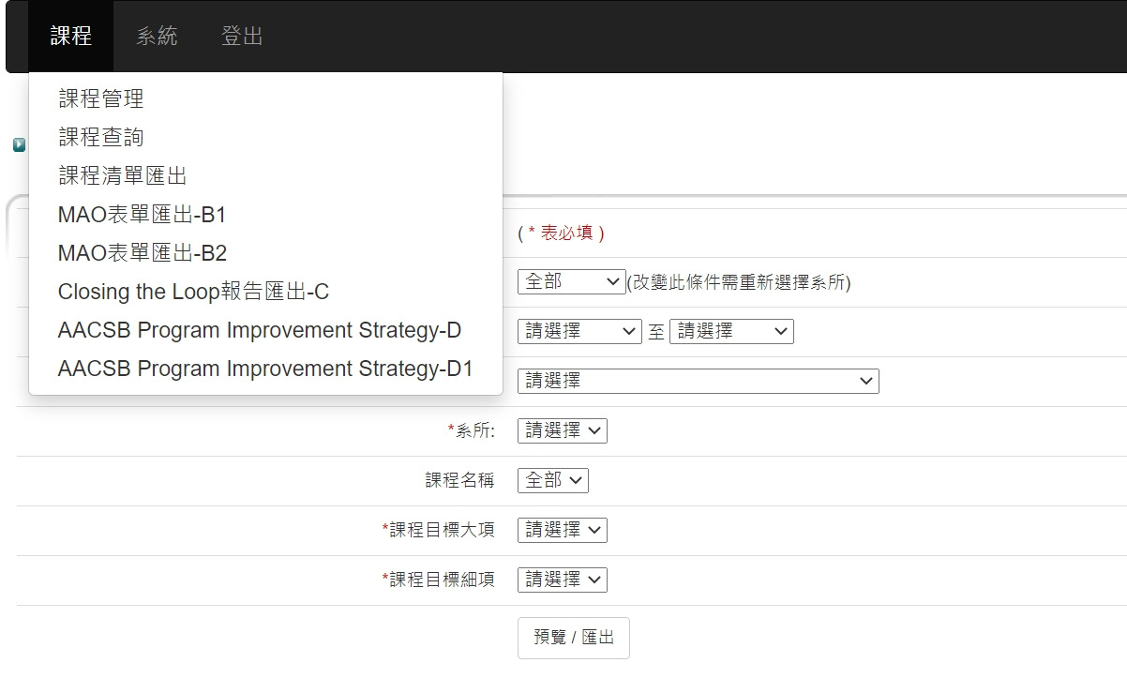
Closing the Loop
Choose Core Course at the first field, select each item according to the selection and fill in at the bottom then export

Slide 33
Q & A
AACSB Online Teaching Platform Website：
http://aacsb.management.ncku.edu.tw/
AACSB Accreditation International Coordinator
Cindy Cho
Tel：06-2757575#53006#38
EMAIL：em53010@email.ncku.edu.tw

Slide 34
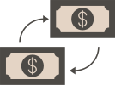
Free Resources
Use these free, recolourable icons and illustrations in your Canva design.

